Slide 1
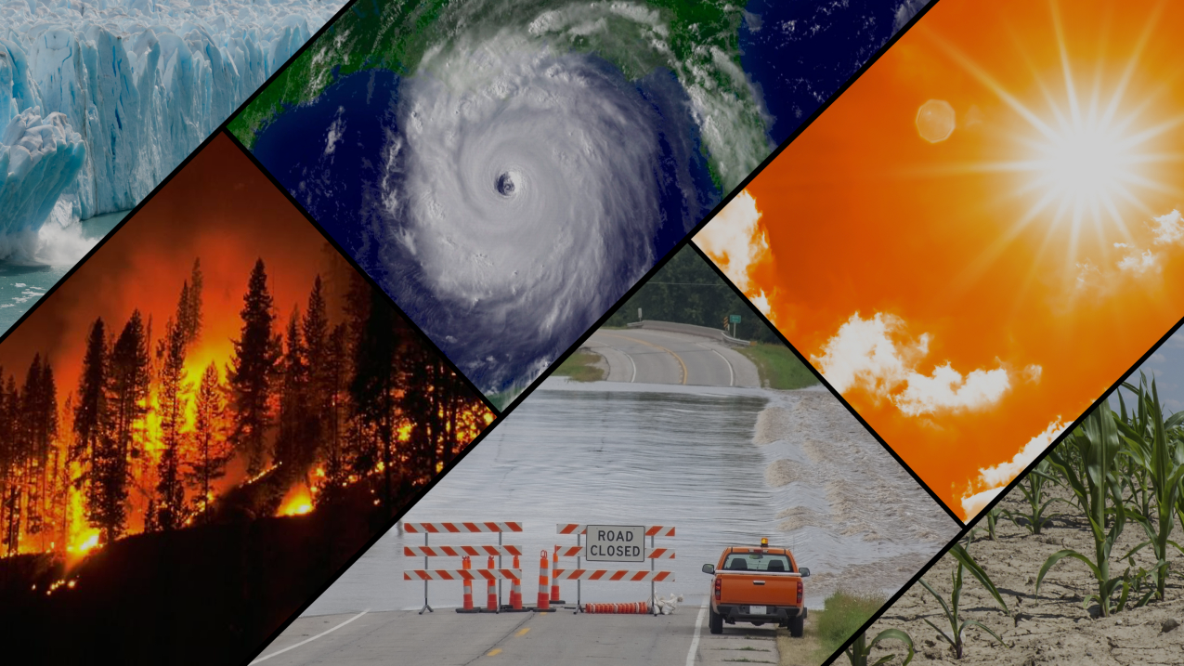
Climate and Real Estate
Esme Rhine, Paul Magarill, Jomo Parke, Andrew Gilbert
Notes:
Andrew
Introduce everyone and the talk about what kind of relationship we were interested in investigating (does climate trends and weather events have a relationship with financial metrics like house valuations)

Slide 2

Questions
Are severe weather events, becoming more frequent over time?
Are severe weather events, becoming more destructive over time?
What is the effect of weather patterns on home prices?
Notes:
Andrew
Explain what question we were trying to answer, and how they relate back to our topic

Slide 3


Data Sources: Atmospheric
Notes:
Andrew
We were able to find data sources from a wide variety of databases both public and private, including NOAA, the NWS and OpenWeather which we used to graph and examine both macro weather trends as well as specific weather events

Slide 4


Data Sources: Financial

Slide 5
Trends
Notes:
Andrew

Slide 6
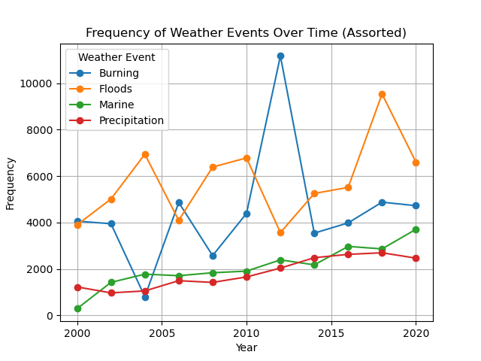
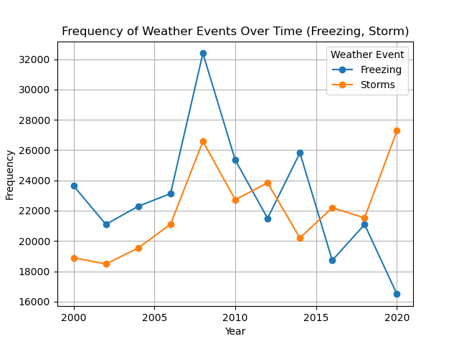
Macro Weather Trends [Frequency] (2000-2020)
Notes:
Andrew
Looking at overall data from 2000-2020 we noticed several upward trends in the frequency of several common weather categories, floods, storms and marine oriented weather events have been increasing in frequency over the last 20 years (give a brief rundown of what the parent categories and their subcategories are)

Slide 7
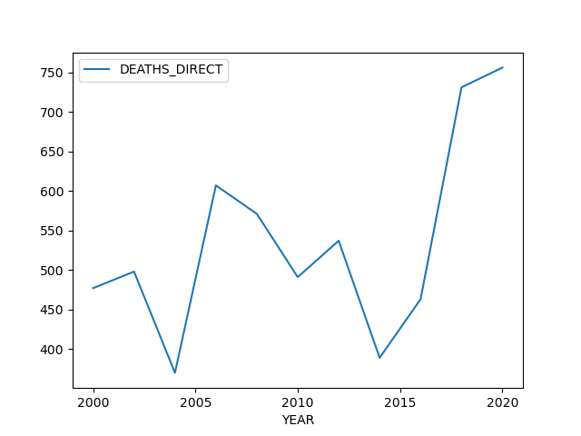
Macro Weather Trends [Fatalities] (2000-2020)
Notes:
Andrew
Looking at overall data from 2000-2020 we noticed several upward trends in the deadliness of several weather categories, with burning experiencing a major uptick in fatalities, storms and marine oriented weather events have been increasing in fatality counts over the last 20 years

Slide 8
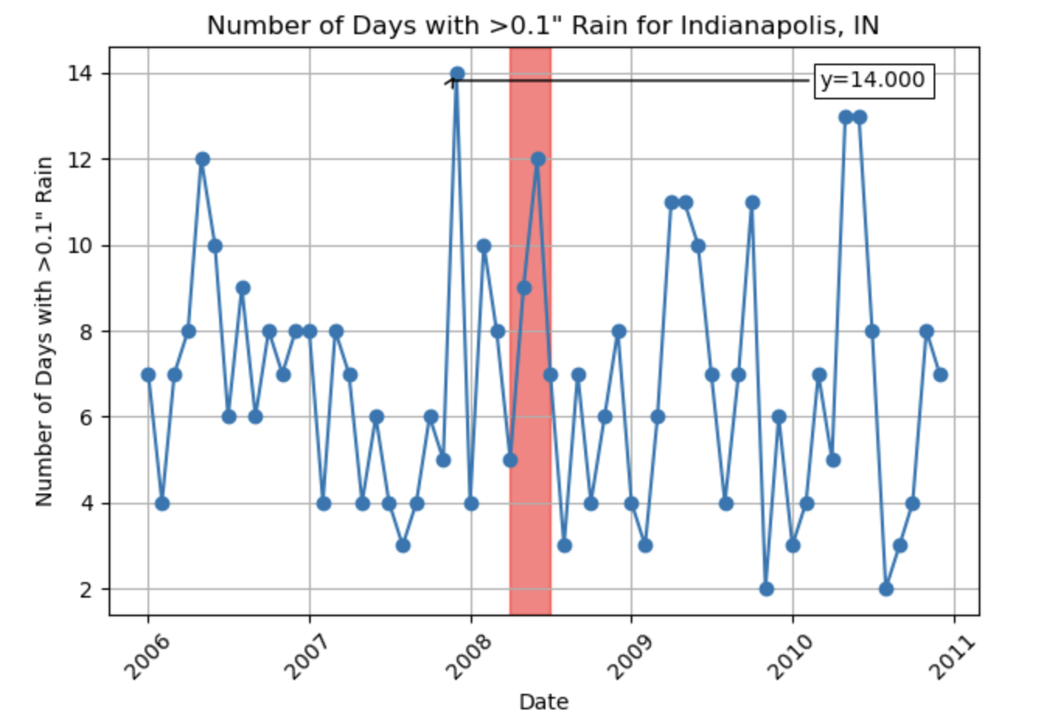
Midwest Flood - Summer 2008
Observations:
A large amount of rain at the end of 2007 damaged levees, leaving the area vulnerable for the flood of 2008
2 months of heavy rain leads to a breach in the levees and significant property damage
Source: https://www.ncei.noaa.gov/cdo-web/api/v2/data?datasetid=GSOM&stationid=GHCND:USW00093819&units=standard&startdate=2006-01-01&enddate=2010-12-30&datatypeid=DP10&limit=1000

Slide 9
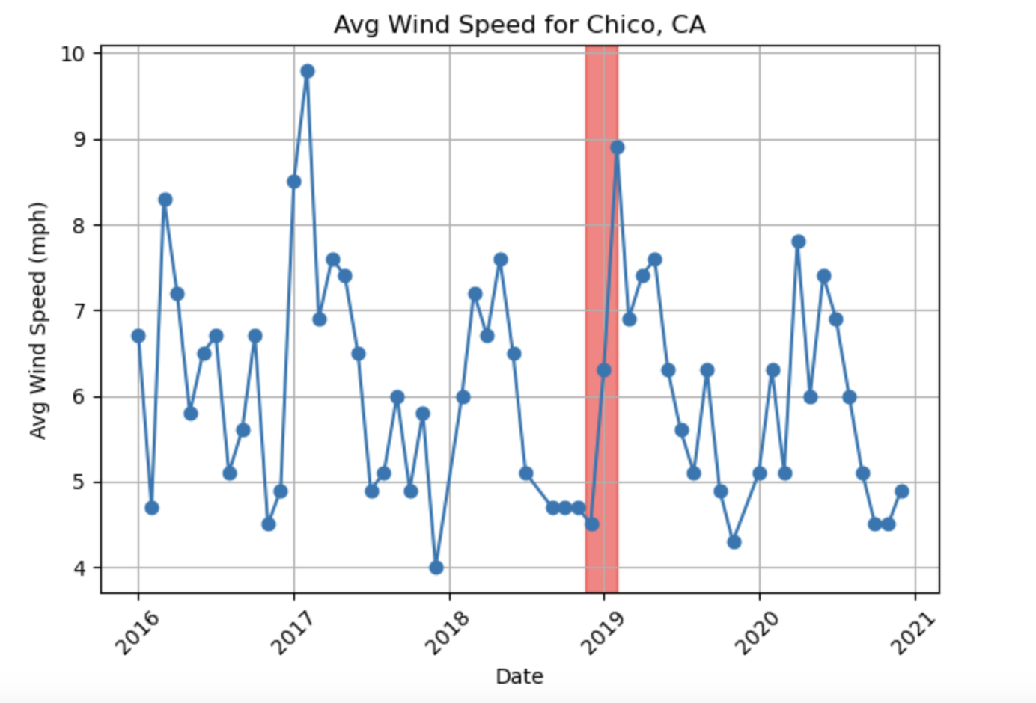
California Wildfires - Winter 2018
Observations:
In November 2018, a transmission line fails and sparks a fire
A severe windstorm drives the fire and makes it impossible to control
Source: https://www.ncei.noaa.gov/cdo-web/api/v2/data?datasetid=GSOM&stationid=GHCND:USW00093210&units=standard&startdate=2016-01-01&enddate=2020-12-31&datatypeid=AWND&limit=1000

Slide 10
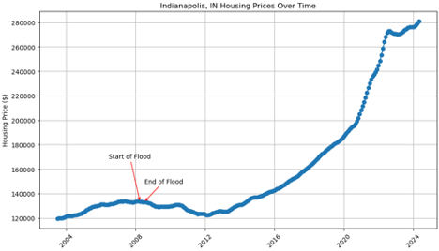
Indianapolis Floods VS House Prices
Insert graphs here
Source: https://www.kaggle.com/datasets/ahmedshahriarsakib/usa-real-estate-dataset https://www.ncei.noaa.gov/cdo-web/api/v2/data?datasetid=GSOM&stationid=GHCND:USW00093819&units=standard&startdate=2006-01-01&enddate=2010-12-30&datatypeid=DP10&limit=1000
Notes:
Midwest Flood April-01-2008 to August-30-2008 Indianapolis, Indiana
Looks no immediate effects, slight dip after the flood might be due to other factors as well

Slide 11
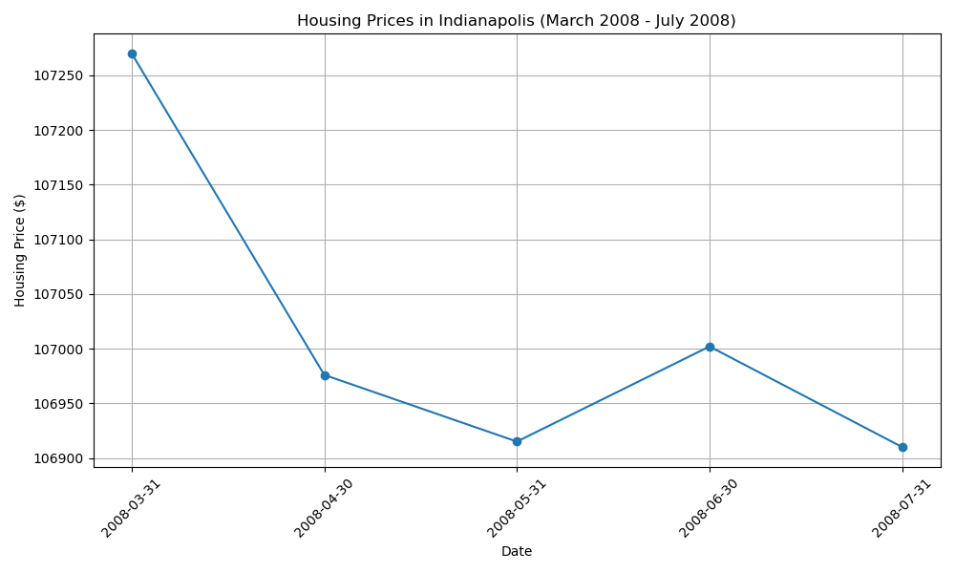
Indianapolis Floods VS House Prices Cont.
Source: https://www.zillow.com/research/data/
Notes:
The data set that i was working with had monthly data so that was helpful to get a closer view
Potential inverse relationship however not much of a price difference to make that claim, nothing immediate at least

Slide 12
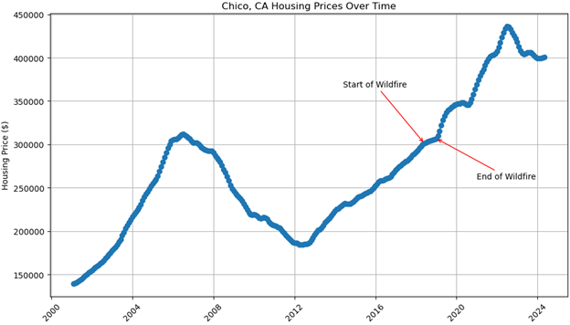
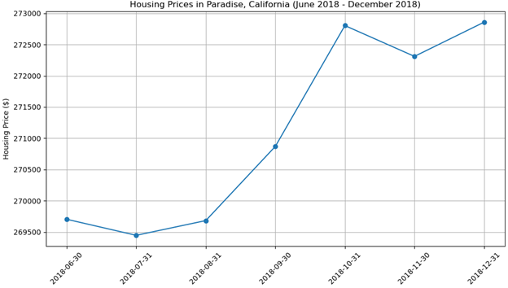
California Wildfire (Summer-Winter 2018)
vs Housing Prices
(the graph on the right is zoomed in to show the area between the two red arrows on the left)
Observations: minimal visual correlations observed.
Sources: https://www.zillow.com/research/data/, https://www.kaggle.com/datasets/christinezinkand/us-billiondollar-weather-and-climate-disasters

Slide 13
Conclusion
Unable to prove a relationship between housing prices and weather events
Additional data sources may help determine otherwise
Control for additional factors

Slide 14
Questions?

